Slide 1
Card sorting
Card sorting is a method used to help design or evaluate information architecture.
The organization and division of content is known as information architecture (IA), and it is a crucial aspect of UX design

Slide 2
Introduction
In a typical card sorting session, participants organize topics into categories that make sense to them and group them accordingly.
To conduct a card sort, you can use actual cards, pieces of paper, or one of several online card-sorting software tools.

Slide 3
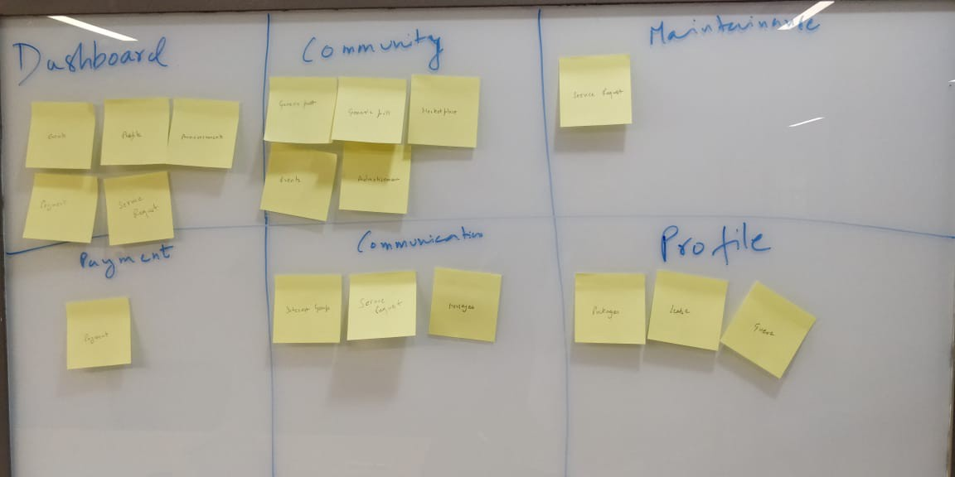
Example:

Slide 4
Check out the video
https://www.youtube.com/watch?v=xUPpG3JCx6I

Slide 5
Types of card sorting -OPEN VS CLOSED
Open — In open card sorting, each participant is given a stack of cards. The participants are then asked to group those cards together in any way they want. Then they create labels for the groups that they chose. This method is commonly used for new/existing information architectures (IA) or organizing products on a site.

Slide 6
OPEN VS CLOSED
Closed — In a closed card sorting, the researchers create the labels for their respective groups. Participants are given a stack of cards and are asked to put each card into a group. This method is normally used when adding new content to an existing site or gaining a second round of insights after an open card sort

Slide 7
Remote vs Face-to-Face
Remote —Remote card sorting sessions are computer-based sessions in which participants work independently on their own personal systems. Open or Closed card sorts both can be done remotely. Several software programs exist to help you with large-scale remote card-sorting studies. Using the software is an advantage because it analyzes the data for you.

Slide 8
Remote vs Face-to-Face
Face to face—This type of sorting session happens in person where an impartial observer is present. Participants are provided with a set of cards and they think aloud while sorting, giving a clearer picture of their reactions and thought processes. The observer has the opportunity to clarify any observations they are unsure of to gain a better insight into why the user has made those choices.

Slide 9
How to do card sorting
1. Create your list of content topics. Topics can be phrases or words, very specific or more general. As a suggestion, limit yourself to 50-60 topics or less. This means there might not be a card to sort for every page on the site.

Slide 10
2. Decide whether you will be doing a physical card sort or using online card-sorting software.

Slide 11
3.Set-up the session
Plan about one hour for each session, longer if you have many cards.
Arrange the space.

Slide 12
4.Lead the session
Show the participant the set of cards. Explain that you are asking for help to find what categories of information should be on the site's homepage and what those categories should be called.

Slide 13
5. Analyze Your Data

